Slide 1

PathFinder
PathFinder
Christopher Costelloe K00233369, Kevin Dunne K00232599, Jekaterina Pavlenko K00224431
Chris Costelloe K00233369, Kevin Dunne K00232599, Jekaterina Pavlenko K00224431

Slide 2

Background
Why we chose this project?
What is learning outcomes?
What is unique about it?

Slide 3
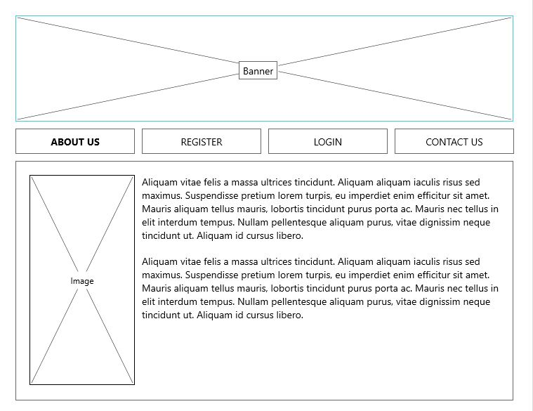
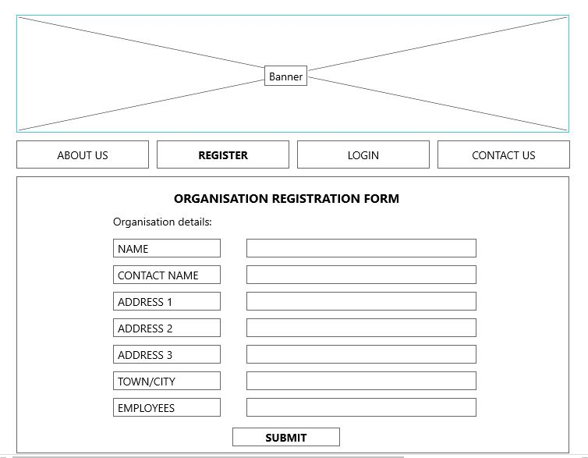
Prototype – Web Application 1
1. Landing Page
2. Organisation Details Form

Slide 4
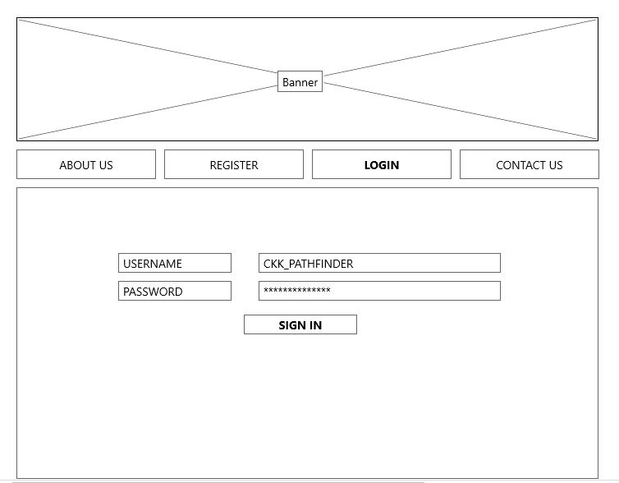
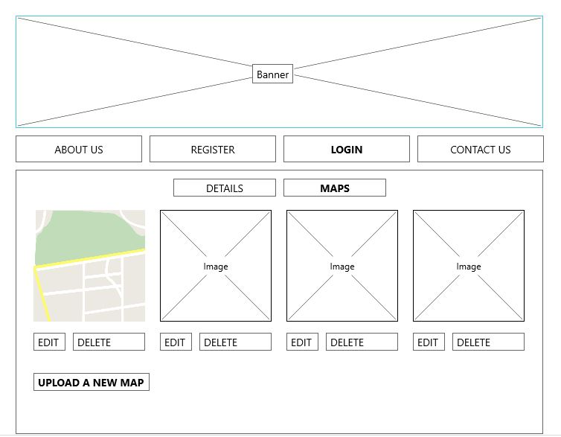
Prototype – Web Application 2
3. Login Page
4. Maps uploading

Slide 5
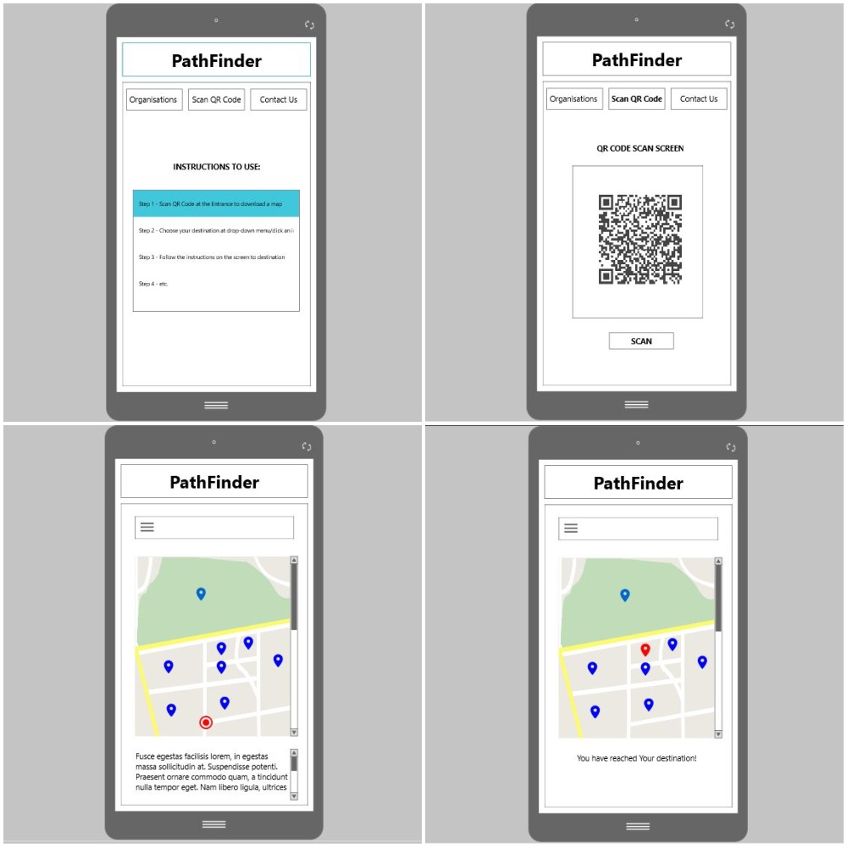
Prototype – Android Mobile Application
Landing Page
Map downloading
QR code scan
Place of destination
1
2
3
4

Slide 6
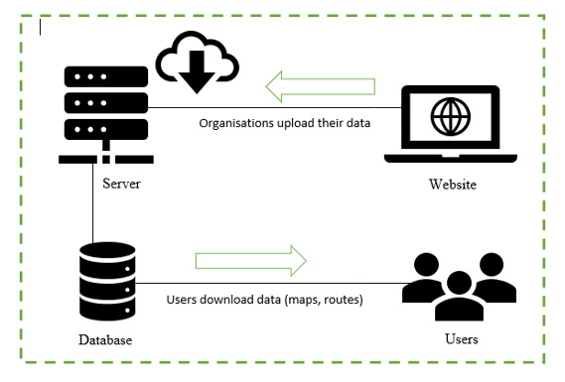
Architecture diagram
Website
Server
Database
User Application

Slide 7
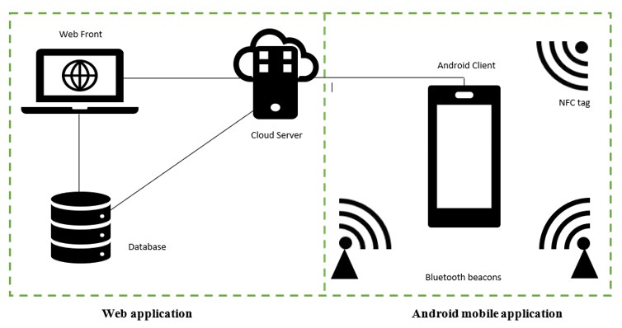
Detailed Architecture diagram
Android Client
Device Connectivity
Server
Database

Slide 8
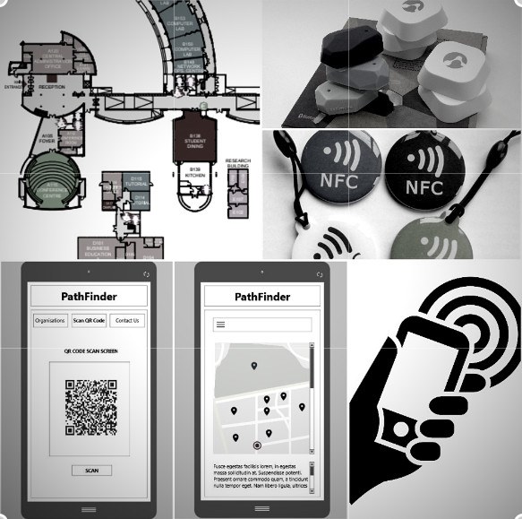
Technologies
List of what we are going to use:
Bluetooth beacons
NFC tags
QR codes
Barcodes

Slide 9
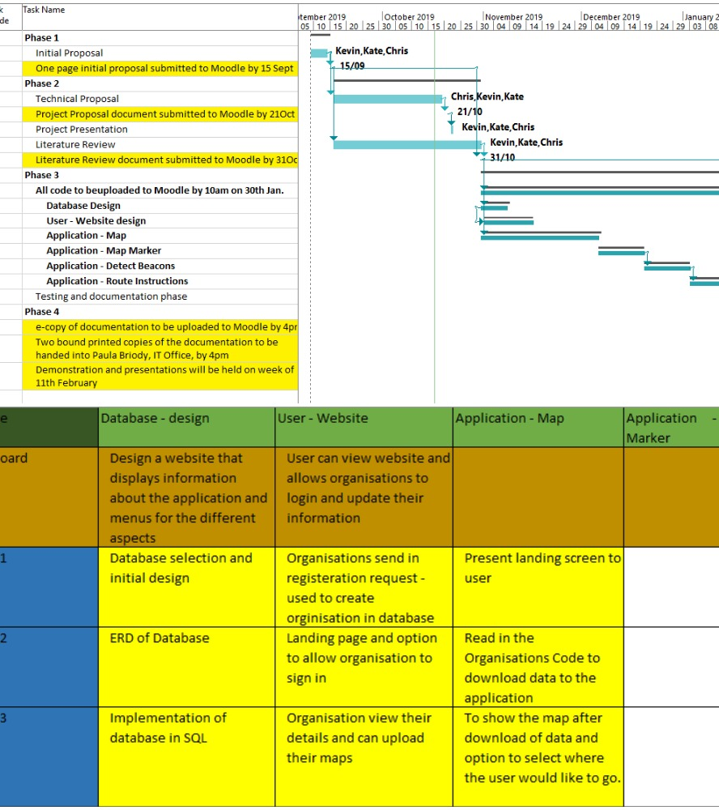
Project Management
Gantt chart & Backlog

Slide 10
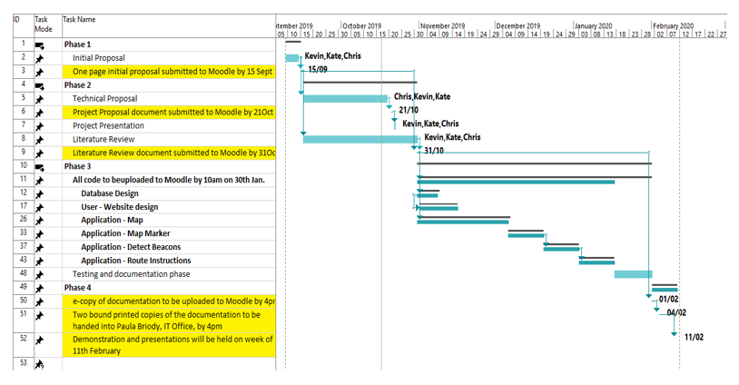
Gantt chart

Slide 11
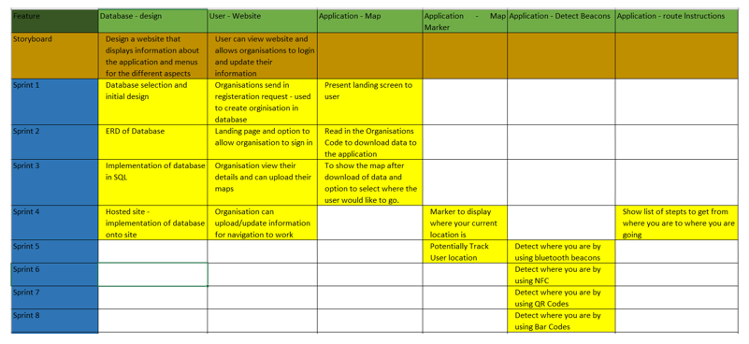
Sprints

Slide 12

Collaboration Tools:
List of what we are using:
GitHub
Google Drive
Messenger
Microsoft Office – Word, Excel etc.

Slide 13

Team Management
Meetings – Chairman, Scribe etc.
GitHub - updates
Problems & solutions

Slide 14

THANK YOU

